Slide 1

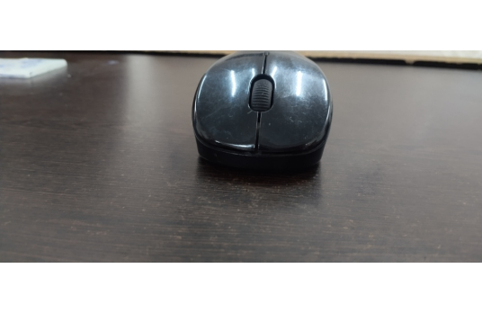
REVERSE ENGINEERING REPORT
Model: Lapcare WL 300
Lapcare 2.4G Wireless Mouse
Teardown, Hardware Inventory & Architectural Analysis
PCB Marking
Power Rating
QKTR-WK-611-4D
5V = 100mA

Slide 2

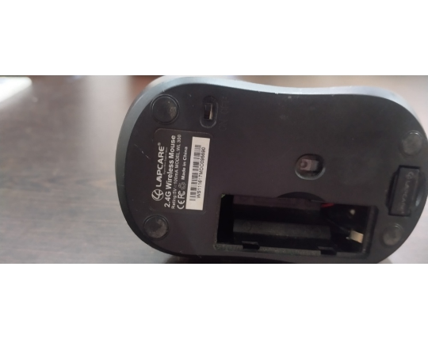
PHYSICAL INSPECTION
External Specifications & Interface
Compact Ergonomic Shell
100mm × 60mm × 38mm form factor.
User Input Features
4 micro-switches plus rotary scroll encoder.
Base Assembly Controls
Optical lens window and ON/OFF slide switch.

Slide 3

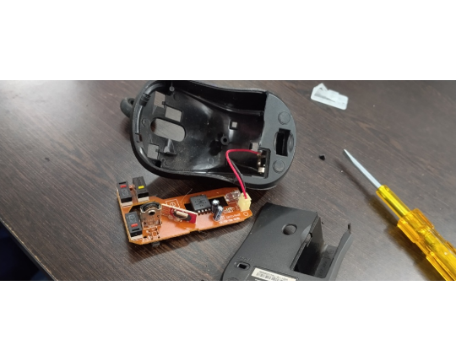
HARDWARE DISASSEMBLY
Teardown Sequence & Structural Isolation
1. Enclosure Fastening
Single bottom retention screw holds housing.
2. Power Interconnect
2-pin white JST header CON1 links battery.
3. Substrate Material
Single-sided paper phenolic board layout.
4. Static Protection
ESD precautions applied before handling ICs.

Slide 4

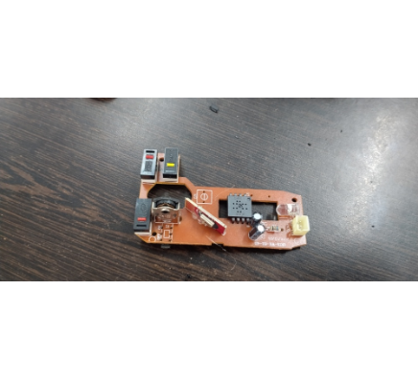
COMPONENT INVENTORY
Internal Bill of Materials (BOM)
Ref | Component | Package | Function
U1 | MCU / Optical IC | Glob-top COB | Motion processing
RF Card | 2.4G Transmitter | Daughterboard | 2.4GHz RF transmission
SW1, SW2 | Micro-switches | Snap Action | Click input triggers
SW3 | Rotary Encoder | Metal Frame | Scroll wheel detection
C1, C2 | Capacitors | 100uF 10V | Power filtering

Slide 5
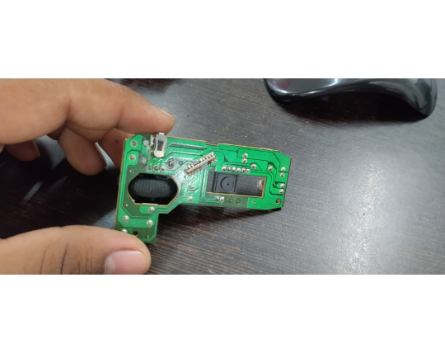
MANUFACTURING ANALYSIS
PCB Design & Cost Engineering
Single-Sided Traces
Paper phenolic substrate minimizes unit cost.
Modular Daughterboard
Vertical RF sub-card enables layout reuse.
Chip-On-Board Packaging
Glob-top epoxy cuts package expense.

Slide 6
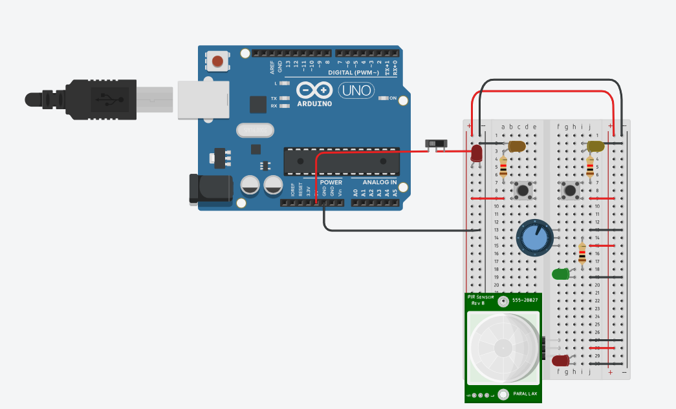
REVERSE ENGINEERING PROJECT SIMULATION
TinkerCAD Simulation
Push Buttons used as Mouse Buttons
2 buttons used
PIR sensor
PIR sensor simulating Mouse’s IR tracking
Potentiometer
Potentiometer used to simulate Mouse’s middle scroll button

Slide 7
SYSTEM ARCHITECTURE
Functional Flow & Design Conclusions
Battery Supply
Switch & Caps
Glob-Top IC
2.4G RF Card
Host PC
Cost Optimization
Modular Production
Repairability Trade-Off
Paper substrate drastically cuts unit cost.
Vertical RF card allows cross-model reuse.
Encapsulated COB limits component repair.
Lapcare WL 300 Teardown Complete
Reverse Engineering Analysis

